Slide 1
Distributed Algorithms 2018/19 Clocks
Danh Le-Phuoc | Open Distributed Systems
With material from R. Karnapke @ KBS & O. Kao @ CIT

Slide 2
Overview
Time in distributed systems
Synchronization of physical clocks
External clock synchronization after Christian
Order of events
Logical Clocks
Lamport clocks
Vector clocks
Application of vector clocks: causal broadcast

Slide 3
Time in Distributed Systems

Slide 4
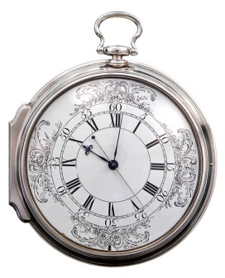
The Importance of Time
The determination of time and the measurement of time durations is indispensable for the coordination of human activities
Therefore, our clocks have to be synchronized
Synchronization of clocks by means of church clock, telegraphy, radio, GPS
Clock synchronization made longitude determination in seafaring possible
We have internalized the existence of a global time
© NMM London, MoD Art Collection

Slide 5
Measuring Time: Overview
Comparing duration to measure with duration of a known action
Sand in an hourglass
Biological processes
Rotation of earth
Phases of moon
Period of a pendulum
Period of an oscillator
Duration of state changes of atoms
...
Assumption: These durations are fixed
Problem: Not always true
But: Depending on accuracy, they are sufficient

Slide 6
Measuring Time: Standardization
Goal: Useful relation to nature
Solar day: Time between two middays (highest angle of sun)
Sun second: 1/86400 of a solar day
Solar days do not have equal length → Averaging over a large number of days
1948: Atomic clock
1 Second = time for 9,192,631,770 state changes of Cesium-133-atom
1 atomic second = average sun second in year of introduction
Bureau International de l’Heure (BHI) determines international atomic time (TAI)

Slide 7
Measuring Time: UTC
Problem: Atomic time does not exactly match solar time
Introduction of Coordinated Universal Time (UTC) with leap seconds
Leap seconds are added (or removed) if difference between solar time and UTC becomes larger than 800 ms.
First leap second 30.06.1972
On average every 19 month
Scheduled always on 30.06. or 31.12.
27 leap seconds occurred by now
Last leap second: End of December 2016 (last minute of month had seconds 0..60)

Slide 8
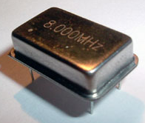
Clocks
Model: a Clock maps the real time t on a time stamp C(t)
Resolution
Smallest period of time by which two values of the clock can differ (e.g., 10ms) → Tick duration
Drift
Deviation of the speed of the clock from real time (about ±10^{–6} with quartz clocks, about ±2s per month)
Offset
Deviation of the clock from the real time at a point in time, i.e., t – C(t)
A perfect clock has a drift and an offset of 0: C(t)=t

Slide 9
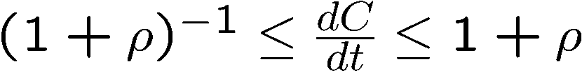
Correct Clocks
„Speed“ of clock
A correct clock has a limited maximal drift ρ
Measured
Time C(t)
too fast
dC / dt > 1
exact dC / dt = 1
too slow
dC / dt < 1
Reference Time t

Slide 10
Application of Time Stamps
Evaluate if data is current
Performance measurements
Determine validity of access authorization
Derive total order of events (e.g., for synchronization, debugging and audit)
Evaluate sensor data and control actuators (real-time systems)
…

Slide 11
Time in Distributed Systems
Each computer has its own inaccurate digital clock
The drifts of the clocks are in general different from each other
Without synchronization, the values of the clocks can differ arbitrarily from each other → clock synchronization needed
Clock synchronization in distributed systems is only possible through message exchange
Hereby, the message delay plays an important role

Slide 12
Synchronization of Physical Clocks

Slide 13
Synchronization Interval
Two correct clocks with drift ρ should not deviate by more than d. How long is the maximum possible interval for synchronization?
Assumptions
At t = 0, the clocks are synchronized: C₁(0) = C₂(0)
Worst case: One clock is as fast as drift allows, the other as slow as drift allows
Without loss of generality:
C₁(t) / t = 1+ ρ (faster)
C₂(t) / t = 1 / (1+ ρ) (slower)

Slide 14
Synchronization Interval
If the clocks are synchronized at t = 0: C₁(t) = (1+ ρ) t and C₂(t) = t / (1+ ρ)
Therefore:
Clocks must be synchronized again before
For very small ρ: Synchronization every d / 2 ρ

Slide 15
Synchronization Interval
Previous slide: Synchronization of two correct clocks (against each other)
Now: Synchronization against a perfect (or assumed to be perfect) clock with maximum deviation d
Assumption again: Clocks are synchronized at t = 0
Two cases: Clock as fast as possible Clock as slow as possible
The clock must be synchronized again before ρ^{–1} d

Slide 16
External Clock Synchronization (Cristian [5], 1989)
Scenario: Process P₂ wants to adjust its clock based on the clock of P₁
Assumption: Message delay x is known
P₁ has a clock with an assumed drift of 0 (e.g., by using an atomic clock)
P₂ adjusts its clock by t₂ + x – t₃
Error of adjustment e_{max} = 0
If the maximal deviation shall stay smaller than d, a new synchronization is at the latest necessary after ρ^{–1} d
Limits for d?
t₂ = 5
t = 7
P₁
P₂ sets its clock
backwards by 1
?
5
P₂
x = 2
t₁
t₃ = 8

Slide 17
Unforeseeable Message Delay
In reality, message delays (in most cases) load-dependent and unlimited
The delay is higher with a high load than with a low load
The delay can be arbitrarily long
the preceding procedure leads only to an approximate adjustment
Probability
min
Message Delay

Slide 18
Synchronization with Unforeseeable Delays
Round Trip Time (RTT) D := (t₃ – t₁)
Let t be the local time of P₁, when P₂ has the local time t₃
t lies in the interval [t₂ + min, t₂ + D – min]
The “best” prediction possible for t is the middle of the interval t₂ + D / 2
Thus, P₂ corrects its clock by t₂ + D / 2 – t₃
The maximal error of this adjustment is e_{max} = D / 2 – min
t₂
t
t₂ + D
min
min
P₁
?
t₂
P₂
t₁
D
t₃

Slide 19
Adjustment of the Local Clock Time
Requirements
Great leaps of the clock time shall be avoided
The clock time must not decrease
Solution
The local clock is run slower or faster until the offset is compensated

Slide 20
Berkeley Algorithm
Developed 1988 at Berkeley University, needs no external time reference
Calculating the average of all clocks
Time demon requests times
Demon adjusts time in system (on all nodes)
Assumption: Correct clocks
What happens if a clock is not correct?
Notes:
A coordinator is chosen to act as the master
Master periodically polls other nodes (slaves) for time values
Use round trip time approach to estimate clock times (see Cristian‘s algorithm) and calculate average
Faulty clocks delivering values far outside of a reasonable range are ignored
Instead of sending updated current time, master sends amount of required adjustment
An election algorithm is used if the master fails

Slide 21
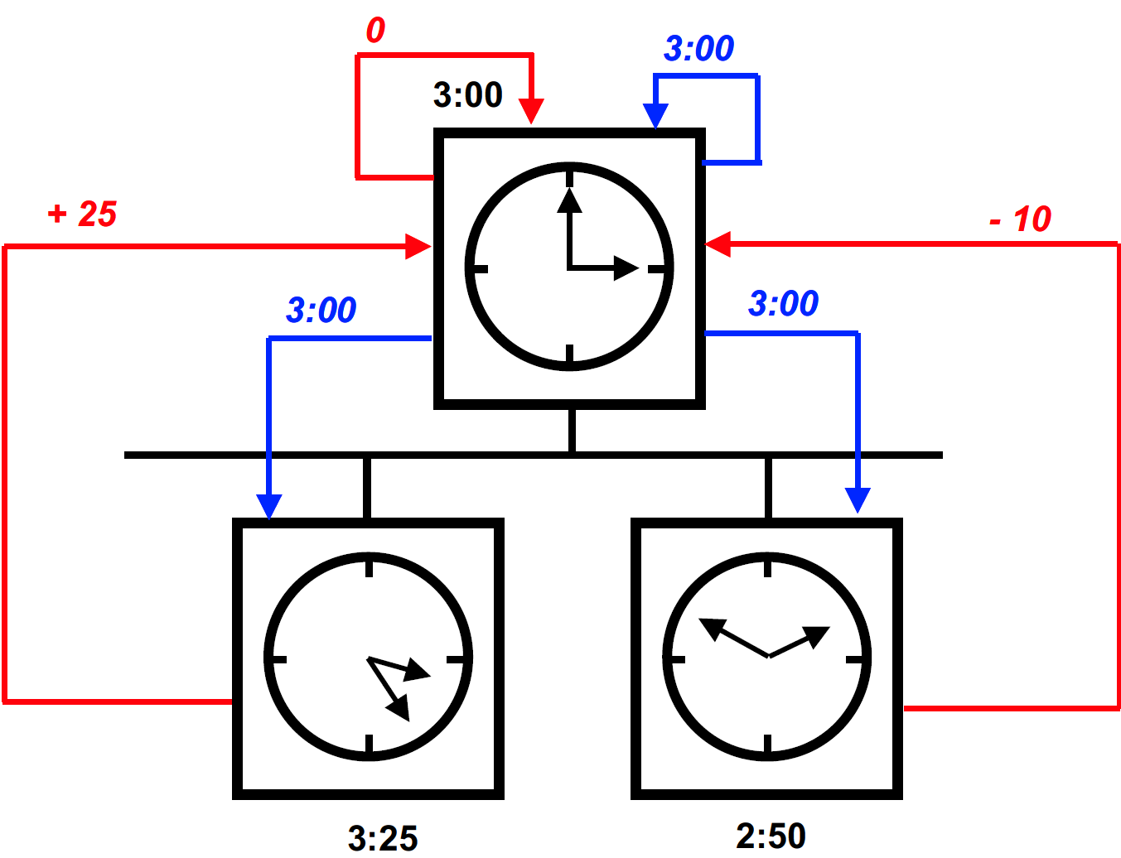
Berkeley Algorithm

Slide 22
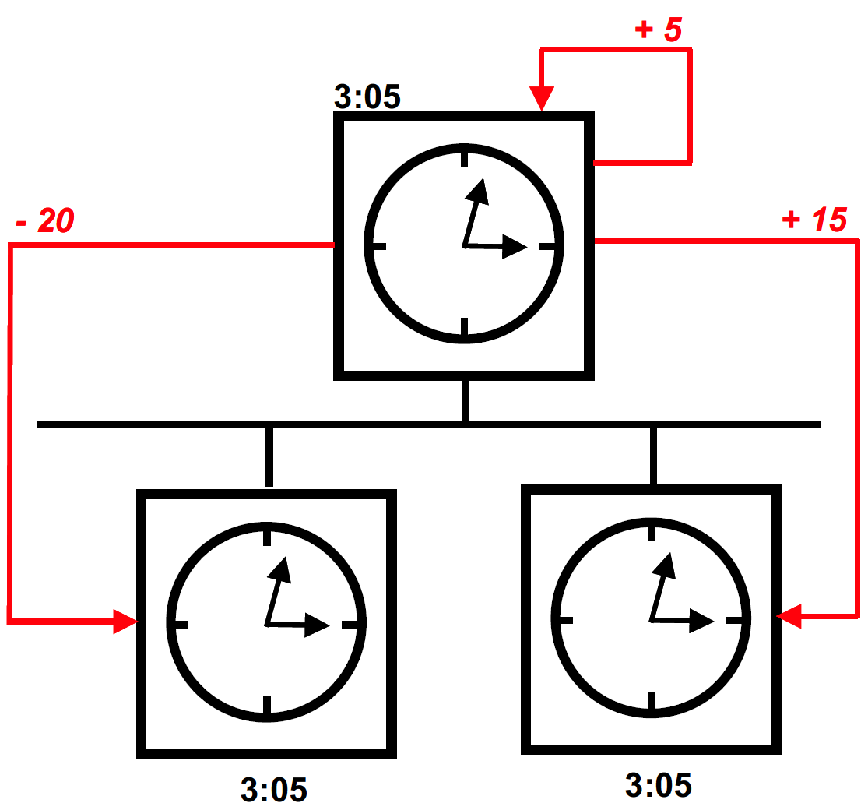
Berkeley Algorithm

Slide 23
Outlook
Network Time Protocol (NTP)
Protocol for the clock synchronization on the Internet [6]
Hierarchy of time servers
Logical clocks as alternative for physical clocks
Allowing e.g. the causal order of events
No relation to the real time

Slide 24
Order of Events

Slide 25
Order of Events in Distributed Systems
Sending and receiving of a message are events → send event, receive event
Additionally, there are local events
In distributed systems, the absolute points in time of events are often not important; it often suffices to order the events
P₁
P₂
P₃
Send Event
Local Event
Receive Event

Slide 26
Order Relations
An order relation < is a
irreflexive for no event a applies a < a
asymmetrical a < b ⇒ ¬(b < a)
transitive a < b ∧ b < c ⇒ a < c
binary relation on the set of all events E
Partial order: The order relation is not defined for all pairs of events
Total Order: The order relation is defined for all pairs of events, i.e. e₁ ≠ e₂ ⇒ e₁ < e₂ ⋁ e₂ < e₁

Slide 27
Possible Order Requirements
FIFO (first in first out) order
Causal order
Total delivery order
Total FIFO order
Total causal order

Slide 28
FIFO Order
If a process sends m₁ before m₂, then m₁ is delivered before m₂ to the receiver
Messages usually belong to a context
Message should find this context (with respect to the sender) at receiver side
Example: “Open file “ before “Write to file”
Note: Messages can overtake each other in the atom model. Therefore, we distinguish between “receive” and “deliver”. Thus, messages can be delayed at the receiver to enforce an order.
Notes:
Remember deliver and receive in multicast

Slide 29
Causal Order: Motivation
FIFO order is related to one sender
But: A received message might cause the receiver to send a new message. Another process might get these two messages in the wrong order, thus observing a reaction before the cause.
In complex contexts (dependence of several senders) not desired
Solution: Keeping causalities based on “happened before” relation
Notes:
e.g. think of group chats

Slide 30
“Happened-Before” Relation (Lamport, 1978)
The relation → („happened before“) on the set of events in the system is the smallest order relation that fulfills the two following conditions
If a and b are two events in a process and a occurs before b, then a → b
If a is the sending of a message in a process and b the receipt of the same message in another process, then a → b
An event b ≠ a causally depends on a, if a → b
Two events a ≠ b are called causally independent, written a || b, if neither a → b nor b → a
Sometimes a || b is also called a and b are concurrent
Attention: The relation || is reflexive but not transitive

Slide 31
“Happened-Before” Relation – Interpretation
a → b ⇒ “b causally depends on a”
a || b ⇒ „a and b have not influenced each other causally“
a → b ⇔ „One can get from a to b in the space-time diagram by following the process lines and message lines from a in the direction of ascending time“
For the example below applies, e.g., e_{1,1} → e_{3,4} and e_{1,6} || e_{2,6}
e_{1,1}
e_{1,2}
e_{1,3}
e_{1,4}
e_{1,5}
e_{1,6}
e_{1,7}
P₁
e_{2,1}
e_{2,2}
e_{2,3}
e_{2,4}
e_{2,5}
e_{2,6}
e_{2,7}
e_{2,8}
P₂
e_{3,1}
e_{3,2}
e_{3,3}
e_{3,4}
P₃

Slide 32
Causal Order
If the sending of message m₂ causally depends on sending the message m₁, then no receiver getting both messages delivers m₂ before m₁
Causal order is stronger than FIFO
Every causal order is also FIFO ordered (Why?)
The inverse does not apply
Causality is hypothetical:
Every possible causality is preserved
It is possible that causal ordered events do not depend on each other

Slide 33
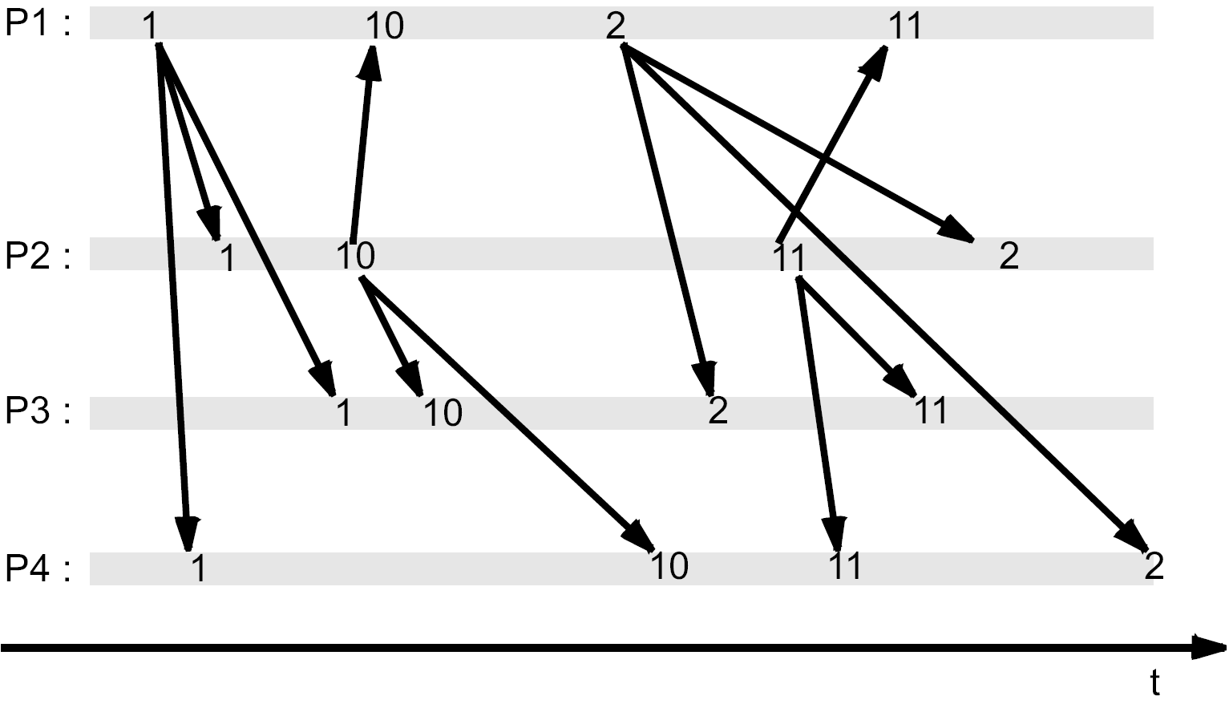
Example: Causal ordered Multicast

Slide 34
Total Delivery Order
If two processes P and Q both deliver the messages m₁ and m₂, then P delivers m₁ before m₂ if and only if Q also does that.
With other words: In case of multicast all receivers deliver the same sequence of messages
Caution: The sequence itself is not specified, especially, causality can be violated
A broadcast with total delivery order is also called atomic broadcast
Caution: A total delivery order is not always total in the sense of a total order

Slide 35
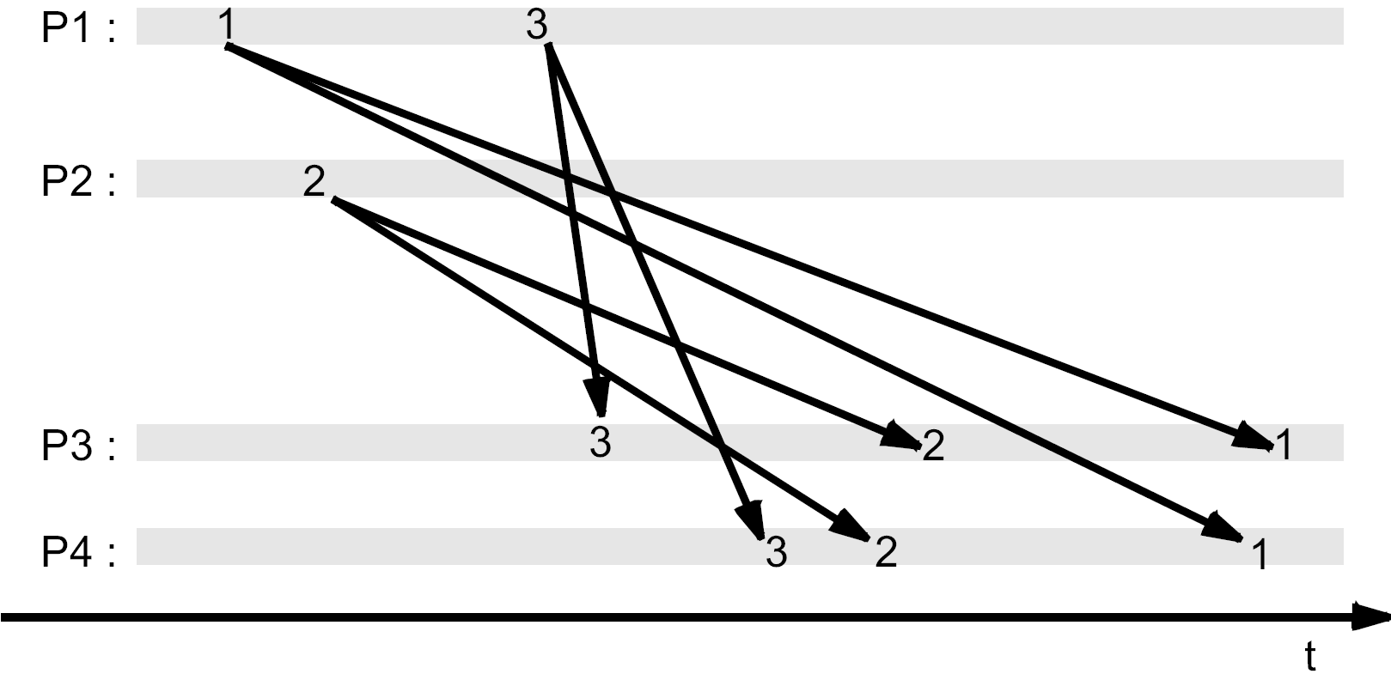
Example for Total Delivery Order

Slide 36
Total FIFO and Causal Order
Total FIFO order
An order that is both FIFO and total with respect to delivery
Total causal order
An order that is both causal and total with respect to delivery

Slide 37
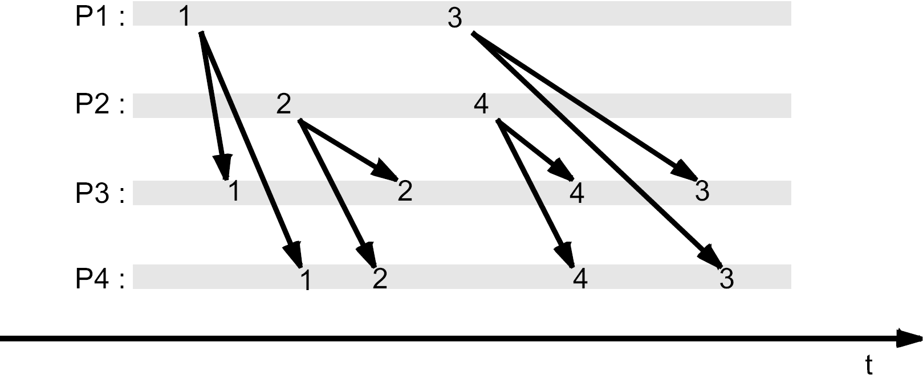
Example for Total FIFO order

Slide 38
Logical Clocks

Slide 39
A Simple Logical Time
A logical clock assigns a time stamp C(e) to each event e
Each process P_{i} manages a counter C_{i}, that is increased by 1 when an event e occurs; the event gets the new value as logical time stamp
The logical time stamps C(e) define a partial order on the set of events
e₁ < e₂ ⇔ C(e₁) < C(e₂)
Supplement to a total order is easily possible through the usage of unique process identities as tiebreaker
The time stamp C´(e_{i}) of an event e_{i} is a pair (C_{i}, P_{i})
e₁ < e₂ ⇔ C´(e₁) < C´(e₂) ⇔ C₁ < C₂ ⋁ C₁ = C₂ ⋀ P₁ < P₂
Since the process identities are unique, for two arbitrary events e₁ ≠ e₂ ⇒ e₁ < e₂ ⋁ e₂ < e₁

Slide 40
A Simple Logical Time – Problem
Problem: The simple logical time does not take the causal correlation between events into account
Example: Replicated article data base
Editor adds a new article
Chief editor redacts the article afterwards
If the second action gets a smaller time stamp than the first one, the actions are applied in the wrong order and the data base contains the article which was not redacted
Idea: Applying the “happened before” relation

Slide 41
Clock Condition (Lamport, 1978)
Requirement to a logical clock (clock condition)
For all events a, b shall apply: a → b ⇒ C(a) < C(b)
Thus, the clock preserves the causal order of the events
Attention: The implication only holds in one direction!
It only applies C(a) < C(b) ⇒ a → b ⋁ a || b
From the clock condition follows: C(a) = C(b) ⇒ a || b
How can a logical clock be realized that fulfills the clock condition?

Slide 42
Lamport’s Clocks – Realization
Each P_{i} has a local logical clock L_{i}, whose value is adapted at the occurrence of the following events:
Local event with process P_{i}
The value of the local clock L_{i} is increased by one
The event gets the new value as time stamp
P_{i} sends a message
The value of the local clock L_{i} is increased by one
The send event gets the new value as time stamp
The sent message m carries t_{m} as time stamp, the time stamp of its send event

Slide 43
Lamport’s Clocks – Realization
Each P_{i} has a local logical clock L_{i}, whose value is adapted at the occurrence of the following events:
P_{i} receives a message
The value of the local clock is adapted to L_{i} := max(L_{i}, t_{m}) + 1
The receive event gets the new value as time stamp
The increment after calculating the maximum ensures that the receive event gets a higher time stamp than the send event and the preceding local event of the receiver

Slide 44
Lamport’s Clocks – Example
1
2
3
4
10
11
12
P₁
2
9
12
4
5
6
7
8
9
10
11
13
P₂
3
8
11
3
4
9
12
P₃

Slide 45
Lamport’s Clocks – Synchronization
Example: processes generate a different number of local events per time unit
P₁
P₂
P₃
P₁
P₂
P₃
0
0
0
0
0
0
6
m
8
10
6
m
8
10
12
16
20
12
16
20
18
24
n
30
18
24
n
30
24
32
40
24
32
40
30
40
50
30
40
50
36
48
o
60
36
48
o
60
42
56
70
42
61
70
48
p
64
80
48
p
69
80
54
72
90
70
77
90
60
80
100
76
85
100
Without Synchronization
With Lamport‘s Algorithm

Slide 46
Lamport’s Clocks – Characteristics
Lamport’s clocks fulfill the clock condition!
The logical time stamps L(e), thus, define a partial order on the set of events that maintains the causal connection between events
Complement to a total order is possible again
Problem: By means of a time stamp one can not always tell for sure, whether two events causally depend on each other; for that purpose also the converse of the clock condition would have to apply

Slide 47
Lamport’s Clocks – Characteristics
Example b and e: although C(𝑒) < C(𝑏), e and b are concurrent, Lamport Clocks infer no knowledge about this!
The partial causal ordering is sometimes too strong, since there is no causal relation between b and e
1
2
p₁
a
b
m₁
Counters
initialized
to 0
3
4
p₂
c
d
m₂
p₃
1
5
e
f

Slide 48
Vector Clocks – Motivation
Assume we had a clock that turns the implication of the clock condition into an equivalence
a → b ⇔ C(a) < C(b)
With such a clock, we could determine how events are related by means of the time stamps of the events
C(a) < C(b) ⇒ a → b
C(b) < C(a) ⇒ b → a
⌐ (C(a) < C(b) ⋁ C(b) < C(a)) ⇒ a || b
Note: For all three equations also the converse applies
Note: For ⌐(C(a) < C(b) ⋁ C(b) < C(a)) we also write shortly C(a) || C(b)
How can a clock with such characteristics be realized?

Slide 49
Vector Clocks – (Mattern, Fidge, 1988)
Each process P_{i} holds a vector time stamp V_{i} consisting of n counters that are initially all zero
Update on local event
If an event occurs in a process P_{i} , it increments the i-th component of its vector
Update when sending a message
If P_{i} sends a message, the new version of V_{i} is sent along (piggybacked)
Update when receiving a message
If P_{i} receives a message with vector time stamp T, it forms the maximum of the new version of V_{i} and T, component-by-component
The vector time can also be extended to a total order by using process identities as tiebreakers with not comparable vectors

Slide 50
Vector Clocks
Component-by component maximum formation of two vectors
max(V_{i}, V_{j}) := (max(V_{i} [1], V_{j} [1]), …, max(V_{i} [n], V_{j} [n]))
Component-by-component comparison of two vectors
V_{i} < V_{j} ⇔ V_{i} ≠ V_{j} ⋀ ∀ 1 ≤ k ≤ n : V_{i} [k] ≤ V_{j} [k]
Vector clocks only define a partial order!
2
2
4
2
8
6
2
3
5
6
8
9
1
2
4
2
5
6
3
5
3
1
8
9
1
2
4
2
5
6
3
5
3
1
8
9
3
5
4
2
8
9
<
||
max
,
=

Slide 51
Vector Clocks – Example
1
0
0
2
0
0
3
0
2
4
2
4
5
2
4
P₁
2
0
0
5
2
4
2
1
0
2
2
0
2
2
4
2
3
5
5
4
5
P₂
0
0
2
2
2
0
2
2
5
0
0
1
0
0
2
2
2
3
2
2
4
2
2
5
P₃

Slide 52
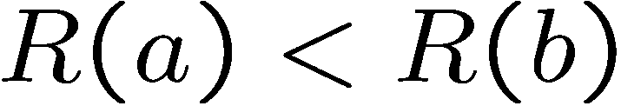
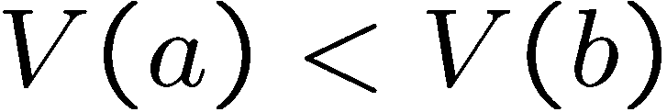


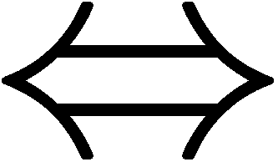



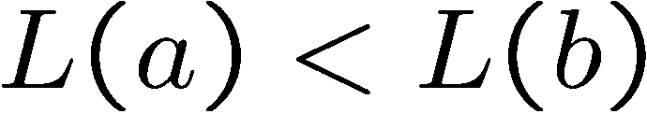
Relation Between the Time Stamps
R(e) exact real time of the event e
L(e) Lamport-time of e
V(a) Vector-time of e

Slide 53
Matrix Clocks
Every process P_{i} has a matrix time stamp M_{i} given by a n x n-matrix initialized by zero matrix
Process P_{i} increases the components M_{i} [ i, i ] (the i-th element at diagonal) by 1, if a local event occurs
Interpretation of the elements of matrix M_{i}
M_{i} [ i, i ] is the local clock P_{i}
M_{i} [ i, l ] is the knowledge of P_{i} on the local clock of P_{l} (the i-th row is the own time vector of P_{i})
M_{i} [ k, l ] is the knowledge of P_{i} on the knowledge of P_{k} on the local clock of P_{l} (the k-th row is the approximation of the time vector of P_{k})

Slide 54
Matrix Clocks
Update, if P_{j} gets a message from P_{i}
Updating the time vector of P_{j} with the time vector of P_{i} 1 ≤ k ≤ n: M_{j} [ j, k ] = max(M_{j} [ j, k ], M [ i, k]) „What P_{j} knows about the local clock of P_{k}“
Updating the knowledge of P_{j} on the time vector of other processes P_{k} 1 ≤ k, l ≤ n: M_{j} [ k, l ] = max(M_{j} [ k, l ], M [ k, l]) „What P_{j} knows about what P_{k} knows on the local clock of P_{l}“
If for the minimum of the i-th column holds min _{1 ≤ k ≤ n} (M_{i} [ k, i ]) = t, than P_{i} knows that every process knows that its local clock is at least at value t
Useful for consistent fault detection and elimination of dispensable information in replicated data sets

Slide 55
Matrix Clocks – Example
1 0 0
0 0 0
0 0 0
2 0 0
0 0 0
0 0 0
3 5 5
1 5 2
1 5 5
P₁
0 0 0
0 1 0
0 0 0
1 0 0
1 2 0
0 0 0
1 0 0
1 3 0
0 0 0
1 0 0
1 4 2
0 0 2
1 0 0
1 5 2
0 0 2
P₂
0 0 0
0 0 0
0 0 1
0 0 0
0 0 0
0 0 2
0 0 0
0 0 0
0 0 3
1 0 0
1 5 2
1 5 4
1 0 0
1 5 2
1 5 5
P₃
P₁ knows that every process knows that its local clock is at least 1.

Slide 56
Application of Vector and Matrix Clocks

Slide 57
Application of Vector Clocks: Causal Broadcast
Each message shall be delivered to all processes
With delivery of the message shall be ensured that the messages are delivered in an order satisfying causality
Change of the update of the vector clocks
P_{i} only increments V_{i} [i] if it sends a message
Delivery condition
A message sent by P_{i} is only delivered to P_{j} when the time stamp T fulfills the following conditions: T [i] = V_{j} [i] + 1 ∧ ∀k≠i: T [k] ≤ V_{j} [k]
Next message awaited by P_{i}
No message from arbitrary P_{k} is missing

Slide 58
Application of Vector Clocks: Causal Broadcast
The maximum of V_{j} and T is derived after the delivery of the appropriate message
Due to the second delivery condition: V_{j} [ k ] ≥ T [ k ] for all k ≠ I i.e., except the component V_{j} [ i ], V_{j} only contains components larger or equal those in T
Due to the first delivery condition, for V_{j} [ i ] holds: V_{j} [ i ] = T [ i ] – 1
Therefore, calculating the maximum is not necessary
Instead, it is sufficient to increase V_{j} [ i ] by one at delivery

Slide 59
Causal Broadcast – Example
0
0
0
1
0
0
2
0
0
3
0
0
P₁
2
0
0
1
0
0
3
0
0
3
1
1
0
0
0
3
1
1
P₂
3
1
1
0
0
0
3
0
1
3
0
1
P₃
delivery

Slide 60
Application of Lamport Clocks: Causal Multicast
Lamport clocks alone are not sufficient for implementing a causal multicast
allow to ensure causal order at receiver, but it is not possible to detect if messages with smaller time stamps are missing
Assuming, we have FIFO channels: a message can safely be delivered if messages with higher time stamps were received from all other processes
This can be ensured by
Processes that periodically send messages or
Requesting messages on demand
Compared to vector clocks, this solution delays delivery even in cases where no messages are missing

Slide 61
Literature
A. Tanenbaum, M. van Steen. Distributed Systems: Principles and Paradigms. Prentice Hall, 2002.
G. Coulouris, J. Dollimore, and T. Kindberg. Distributed Systems: Concepts and Design. Addison-Wesley, 4th edition, 2005. Chapter 11.1 – 11.4
N. Lynch. Distributed Algorithms. Morgan Kaufmann, 1996. Chapter 18
F. Mattern. Verteilte Basisalgorithmen. Springer-Verlag, 1989. Virtuelle Zeit in verteilten Systemen
F. Cristian. Probabilistic clock synchronization. Distributed Computing, 3(3):146--158, 1989.
D. L. Mills. Network Time Protocol (Version 3). Internet Request for Comments RFC 1305, 1992.
L. Lamport. Time, Clocks, and the Ordering of Events in a Distributed Environment. Communications of the ACM, 21:558--564, July 1978.
F. Mattern. Virtual Time and Global States of Distributed Systems. In C. M. et al., editor, Proc. Workshop on Parallel and Distributed Algorithms, pages 215--226, North-Holland / Elsevier, 1989.
Michel Raynal. About logical clocks for distributed systems. SIGOPS Oper. Syst. Rev. 26, pp. 41-48, 1992.

